Slide 1
3D reconstruction class 11
Multiple View Geometry
Comp 290-089
Marc Pollefeys

Slide 2
Content
Background: Projective geometry (2D, 3D), Parameter estimation, Algorithm evaluation.
Single View: Camera model, Calibration, Single View Geometry.
Two Views: Epipolar Geometry, 3D reconstruction, Computing F, Computing structure, Plane and homographies.
Three Views: Trifocal Tensor, Computing T.
More Views: N-Linearities, Multiple view reconstruction, Bundle adjustment, auto-calibration, Dynamic SfM, Cheirality, Duality

Slide 3
Multiple View Geometry course schedule
(subject to change)
Jan. 7, 9 | Intro & motivation | Projective 2D Geometry
Jan. 14, 16 | (no class) | Projective 2D Geometry
Jan. 21, 23 | Projective 3D Geometry | (no class)
Jan. 28, 30 | Parameter Estimation | Parameter Estimation
Feb. 4, 6 | Algorithm Evaluation | Camera Models
Feb. 11, 13 | Camera Calibration | Single View Geometry
Feb. 18, 20 | Epipolar Geometry | 3D reconstruction
Feb. 25, 27 | Fund. Matrix Comp. | Structure Comp.
Mar. 4, 6 | Planes & Homographies | Trifocal Tensor
Mar. 18, 20 | Three View Reconstruction | Multiple View Geometry
Mar. 25, 27 | MultipleView Reconstruction | Bundle adjustment
Apr. 1, 3 | Auto-Calibration | Papers
Apr. 8, 10 | Dynamic SfM | Papers
Apr. 15, 17 | Cheirality | Papers
Apr. 22, 24 | Duality | Project Demos

Slide 4

Two-view geometry
Epipolar geometry
3D reconstruction
F-matrix comp.
Structure comp.

Slide 5
Three questions:
Correspondence geometry: Given an image point x in the first image, how does this constrain the position of the corresponding point x’ in the second image?
(ii) Camera geometry (motion): Given a set of corresponding image points {x_{i} ↔x’_{i}}, i=1,…,n, what are the cameras P and P’ for the two views?
(iii) Scene geometry (structure): Given corresponding image points x_{i} ↔x’_{i} and cameras P, P’, what is the position of (their pre-image) X in space?

Slide 6
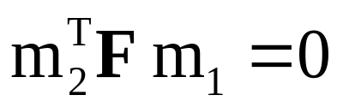

Epipolar geometry
P
P
L2
L2
Underlying structure in set of matches for rigid scenes
m1
m1
C1
m1
C1
C1
M
M
L1
L1
l1
l1
e1
l^{T}₁
l₂
e1
e2
e2
m2
m2
m2
l2
l2
l2
Fundamental matrix (3x3 rank 2 matrix)
C2
C2
C2
Computable from corresponding points
Simplifies matching
Allows to detect wrong matches
Related to calibration
Canonical representation:

Slide 7
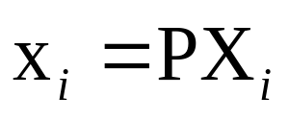
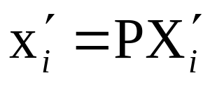
3D reconstruction of cameras and structure
reconstruction problem:
given x_{i}↔x‘_{i} , compute P,P‘ and X_{i}
for all i
without additional informastion possible up to projective ambiguity

Slide 8
outline of reconstruction
Compute F from correspondences
Compute camera matrices from F
Compute 3D point for each pair of corresponding points
computation of F
use x‘_{i}Fx_{i}=0 equations, linear in coeff. F
8 points (linear), 7 points (non-linear), 8+ (least-squares)
(more on this next class)
computation of camera matrices
use
triangulation
compute intersection of two backprojected rays

Slide 9
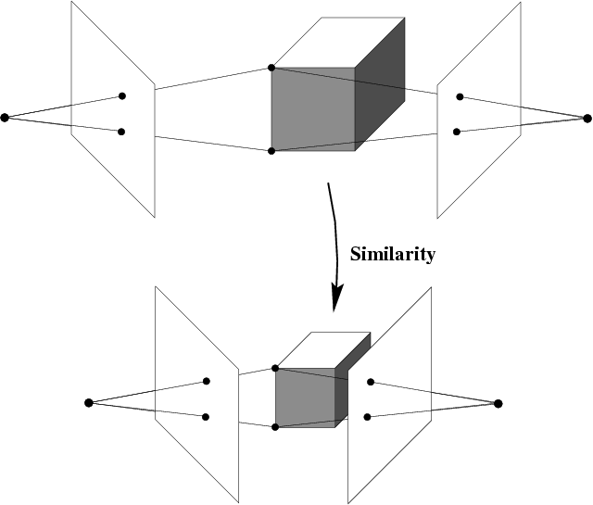
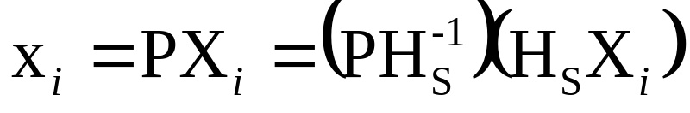
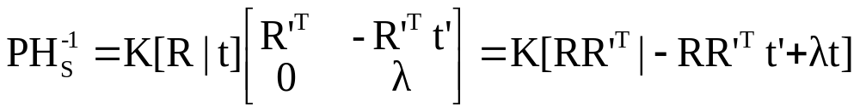
Reconstruction ambiguity: similarity

Slide 10
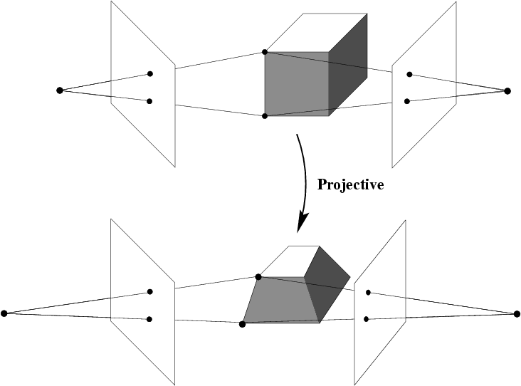
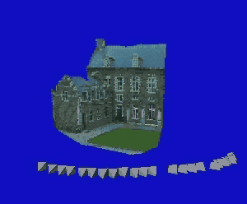
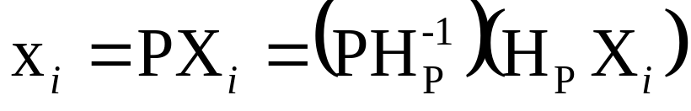
Reconstruction ambiguity: projective

Slide 11
Terminology
x_{i}↔x‘_{i}
Original scene X_{i}
Projective, affine, similarity reconstruction
= reconstruction that is identical to original up to
projective, affine, similarity transformation
Literature: Metric and Euclidean reconstruction
= similarity reconstruction

Slide 12







The projective reconstruction theorem
If a set of point correspondences in two views determine the fundamental matrix uniquely, then the scene and cameras may be reconstructed from these correspondences alone, and any two such reconstructions from these correspondences are projectively equivalent
theorem from last class
along same ray of P₂, idem for P‘₂
two possibilities: X_{2i}=HX_{1i}, or points along baseline
key result:
allows reconstruction from pair of uncalibrated images

Slide 13
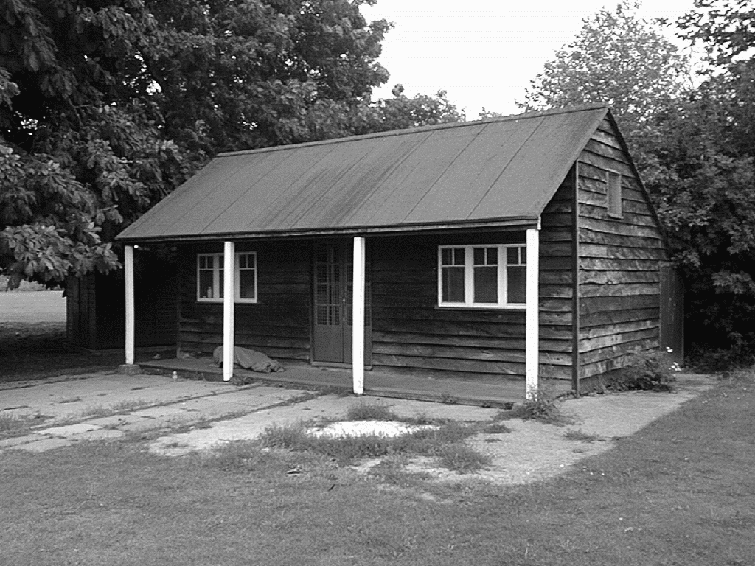
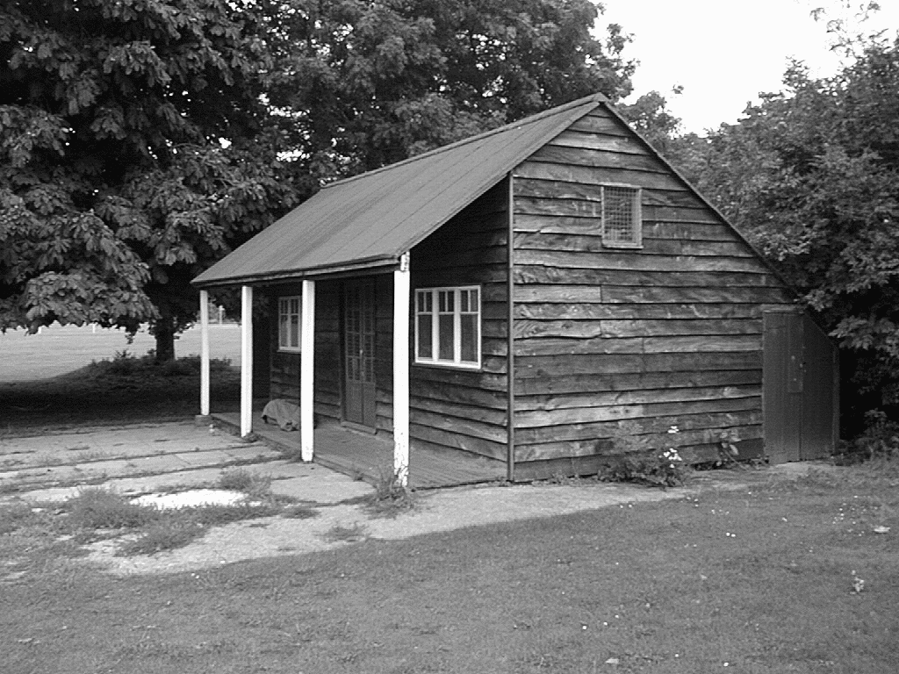
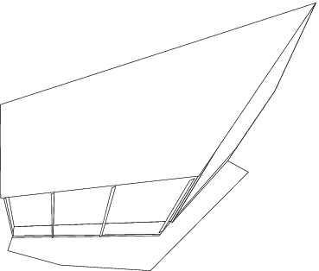
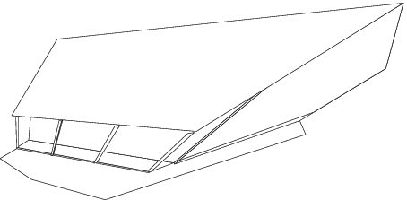

Slide 14
Stratified reconstruction
Projective reconstruction
Affine reconstruction
Metric reconstruction

Slide 15
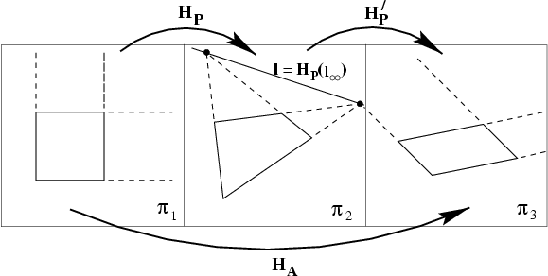
Projective to affine
remember 2-D case

Slide 16

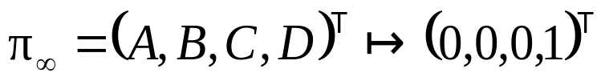
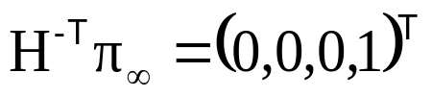
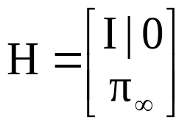
Projective to affine
(if D≠0)
theorem says up to projective transformation,
but projective with fixed π∞ is affine transformation
can be sufficient depending on application,
e.g. mid-point, centroid, parallellism

Slide 17




Translational motion
points at infinity are fixed for a pure translation
⇒ reconstruction of x_{i}↔ x_{i} is on π∞

Slide 18
Scene constraints
Parallel lines
parallel lines intersect at infinity
reconstruction of corresponding vanishing point yields
point on plane at infinity
3 sets of parallel lines allow to uniquely determine π∞
remark: in presence of noise determining the intersection of parallel lines is a delicate problem
remark: obtaining vanishing point in one image can be sufficient

Slide 19
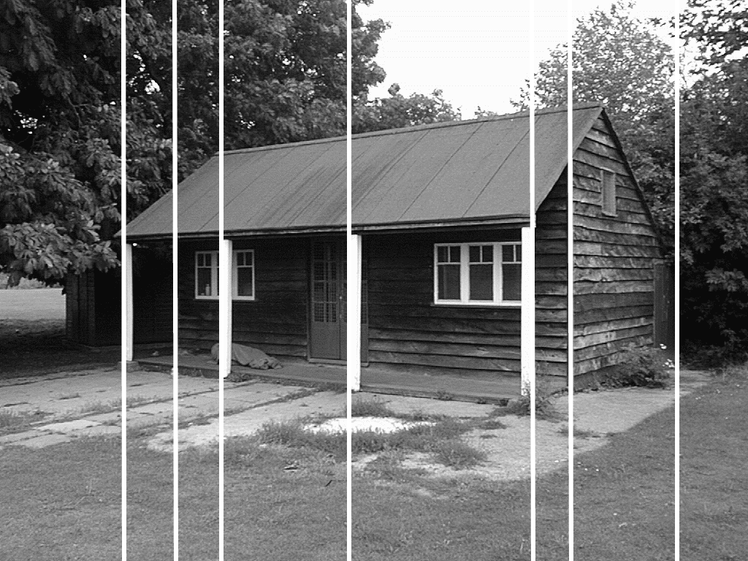
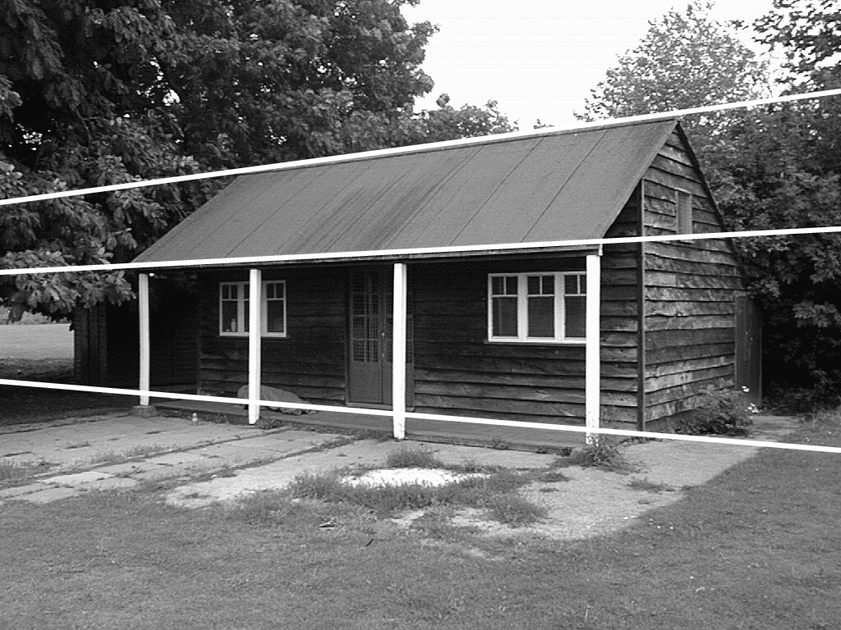
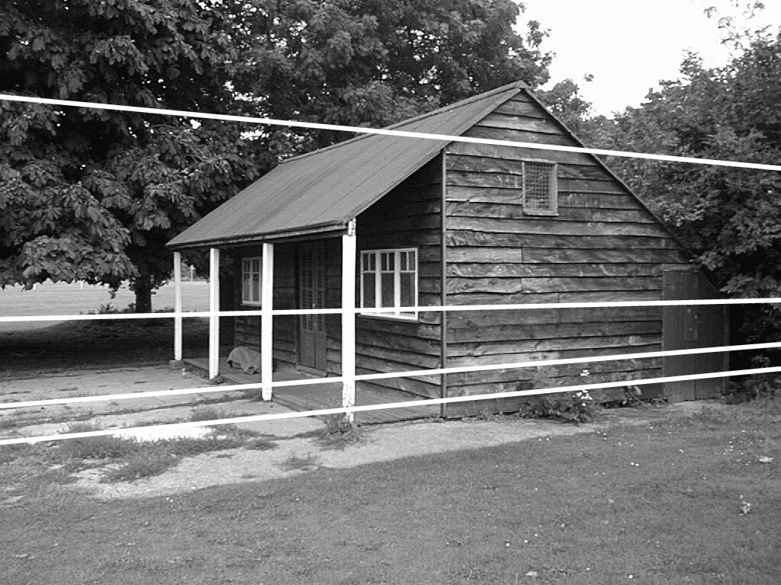
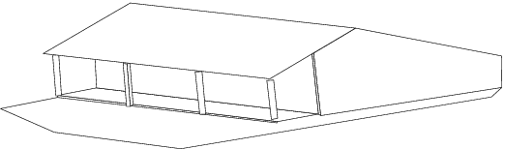
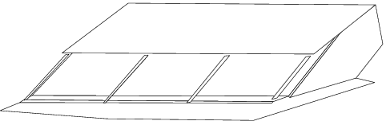
Scene constraints

Slide 20
Scene constraints
Distance ratios on a line
known distance ratio along a line allow to determine point at infinity (same as 2D case)

Slide 21

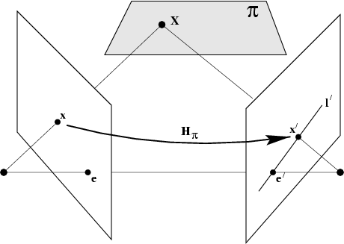





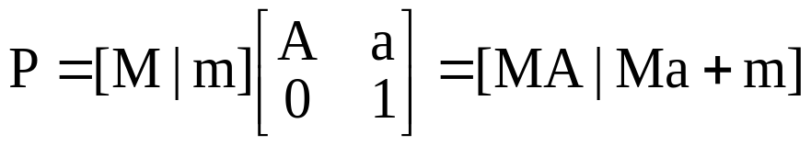


The infinity homography
∞
∞
unchanged under affine transformations
affine reconstruction

Slide 22
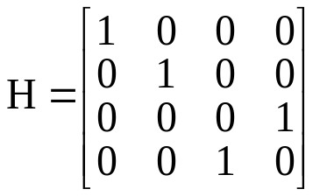
One of the cameras is affine
according to the definition,
the principal plane of an affine camera is at infinity
to obtain affine recontruction,
compute H that maps third row of P to (0,0,0,1)^{T}
and apply to cameras and reconstruction
e.g. if P=[I|0], swap 3rd and 4th row, i.e.

Slide 23


Affine to metric
identify absolute conic
transform so that
then projective transformation relating original and reconstruction is a similarity transformation
in practice, find image of Ω∞
image ω∞ back-projects to cone that intersects π∞ in Ω∞
Ω*
ω*
projection
constraints
note that image is independent of particular reconstruction

Slide 24

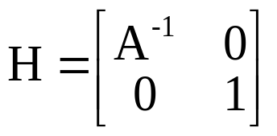
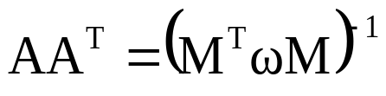

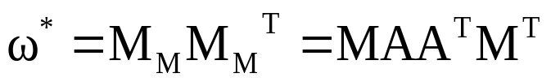
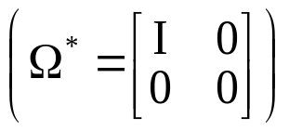

Affine to metric
given
possible transformation from affine to metric is
(cholesky factorisation)
proof:

Slide 25


Ortogonality
vanishing points corresponding to orthogonal directions
vanishing line and vanishing point corresponding
to plane and normal direction

Slide 26



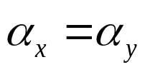

known internal parameters
rectangular pixels
square pixels

Slide 27
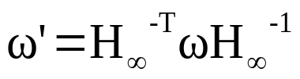
Same camera for all images
same intrinsics ⇒ same image of the absolute conic
e.g. moving cameras
given sufficient images there is in general only one
conic that projects to the same image in all images,
i.e. the absolute conic
This approach is called self-calibration, see later
transfer of IAC:

Slide 28

Direct metric reconstruction using ω
approach 1
calibrated reconstruction
approach 2
compute projective reconstruction
back-project ω from both images
intersection defines Ω∞ and its support plane π∞
(in general two solutions)

Slide 29
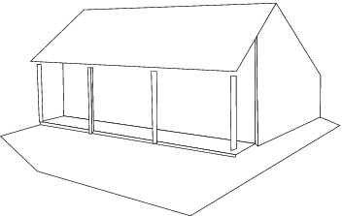
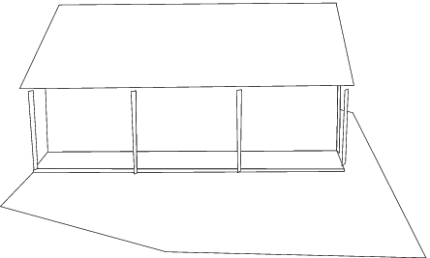
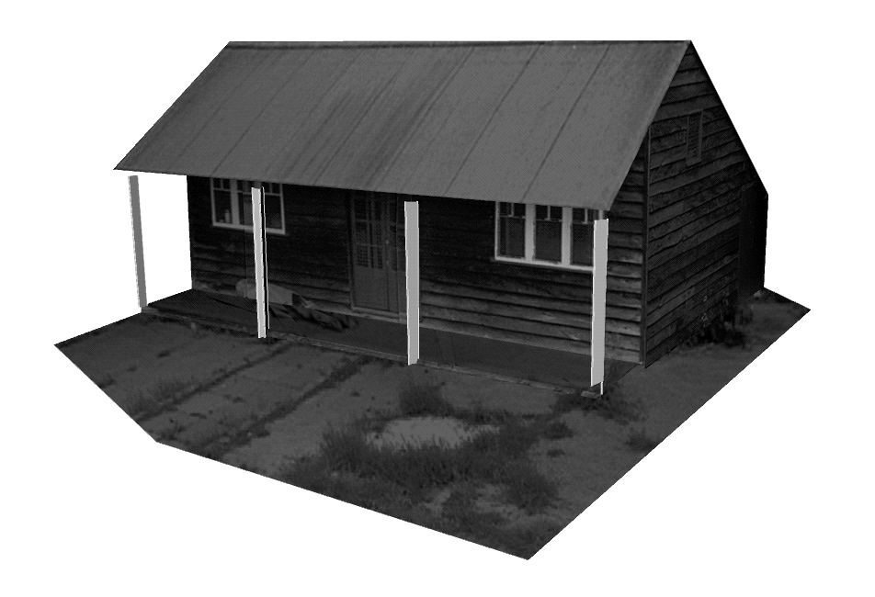
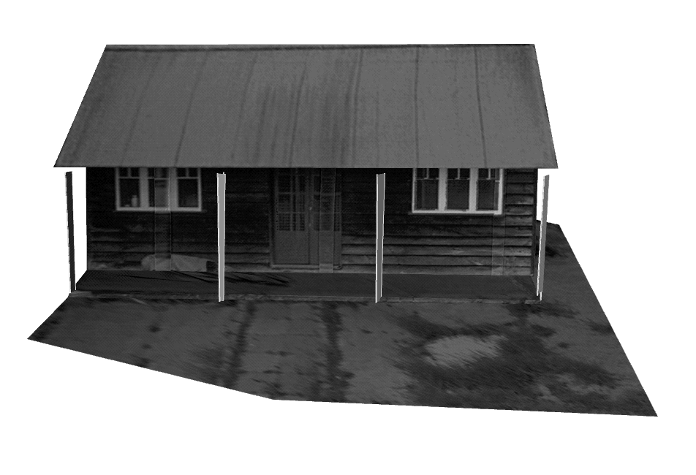

Slide 30
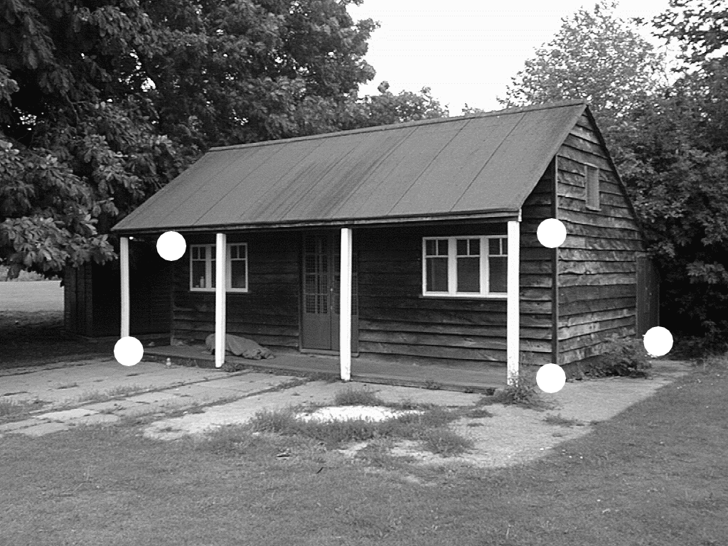

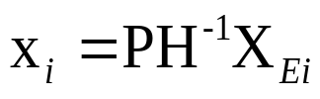
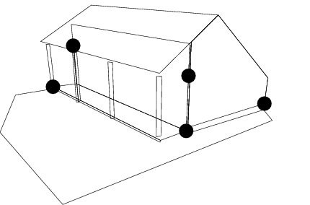
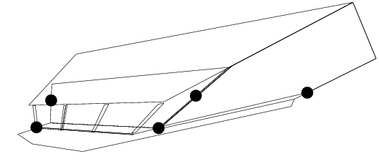
Direct reconstruction using ground truth
use control points X_{Ei} with know coordinates
to go from projective to metric
(2 lin. eq. in H⁻¹ per view,
3 for two views)

Slide 31



Objective
Given two uncalibrated images compute (P_{M},P‘_{M},{X_{Mi}})
(i.e. within similarity of original scene and cameras)
Algorithm
Compute projective reconstruction (P,P‘,{X_{i}})
  Compute F from x_{i}↔x‘_{i}
  Compute P,P‘ from F
  Triangulate X_{i} from x_{i}↔x‘_{i}
Rectify reconstruction from projective to metric
  Direct method: compute H from control points
  Stratified method:
  Affine reconstruction: compute π∞
  Metric reconstruction: compute IAC ω

Slide 32
Image information provided | View relations and projective objects | 3-space objects | reconstruction ambiguity
point correspondences | F |  | projective
point correspondences including vanishing points | F,H∞ | π∞ | affine
Points correspondences and internal camera calibration | F,H∞ ω,ω’ | π∞ Ω∞ | metric

Slide 33
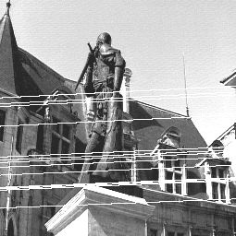
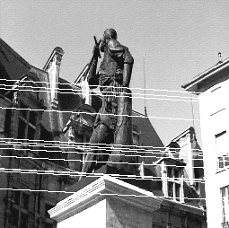
Next class: Computing F

